Slide 1
Computing with Turing Machines

Slide 2


Conventions for using Turing Machines

Slide 3

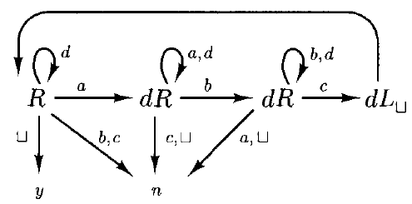
Language Recognition using Turing Machines

Slide 4
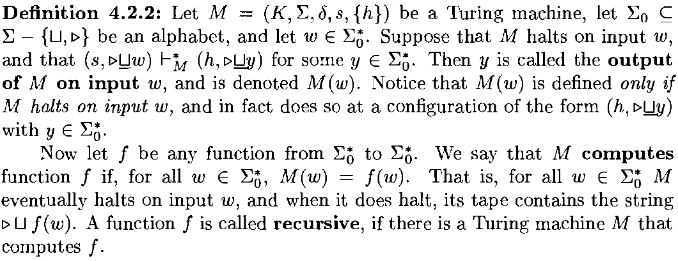

Recursive Functions

Slide 5


Recursive Functions

Slide 6

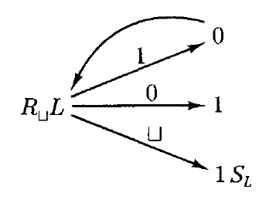

Recursive Functions

Slide 7



Recursively Enumerable Languages

Slide 8


Recursively Enumerable Languages

Slide 9
